Slide 2
But really… what is a set?
A set is a magic bag that can contain anything or nothing...

Slide 3
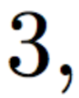
Writing a set:
First, we can list the elements:
Write these to mean it’s
a set

Slide 4
Writing a set: (no repetition)
We don’t stutter when we write a set!

Slide 5
Writing a set: (no repetition)
We don’t stutter when we write a set!

Slide 6
Writing a set: (ORDER IS NOT IMPORTANT)

Slide 7
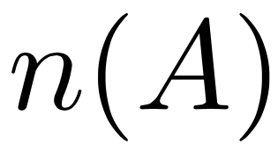
Cardinality:
We denote the number of elements of a set as

Slide 8
Example
3

Slide 9
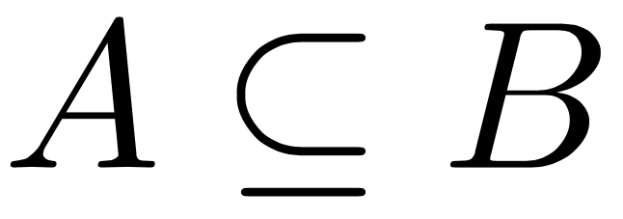
Subsets
Definition: A subset is made of only the elements of another set.
If A is a subset of B we write:

Slide 10
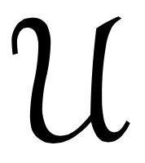
Universe (of discourse)
We at times discuss the subsets of a given “larger set” this set is referred as The Universe of discourse, If this set doesn’t already have a name we usually denote it as:

Slide 11
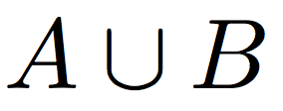
The Union:
Definition: The Union of two sets A, B is
It’s all the stuff in A or B….
so if it’s in A it’s in the union, also if it’s in B it must be in the union..

Slide 13
Let’s write the sets?
First, Andy’s set:

Slide 14
Let’s write the sets?
Now, Bob’s set:

Slide 15
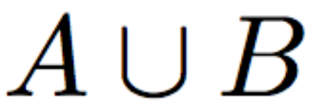
Let’s see it:

Slide 16
Let’s see it:

Slide 17
The intersection:
Definition: The intersection of two sets, is the set of elements that they share...
It’s all the stuff in A and B….
so if it’s in A it’s in the intersection only if it’s also in B...

Slide 18
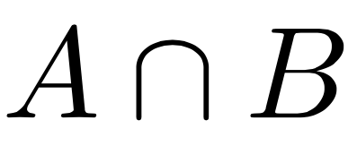
Let’s see it:

Slide 19
Let’s see it:

Slide 20
Now You Try!:

Slide 21
Complements (everything not in!)
Definition: The complement of a set is the set of everything that’s in the universe but NOT the original set

Slide 22
Example

Slide 23
Example

Slide 24
Now You Try!:
7
Given the universe above, find the complement of the following sets:
7

Slide 25
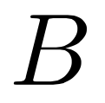
Venn Diagrams

Slide 26
Venn Diagrams (Bob and Andy)

Slide 27
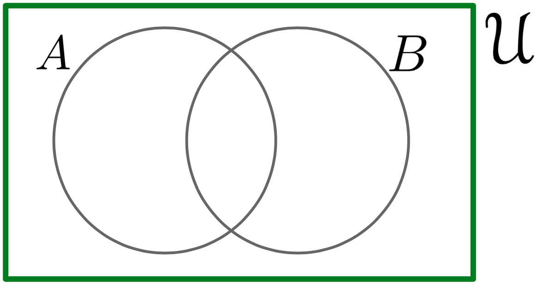
Venn Diagrams (Union)

Slide 28
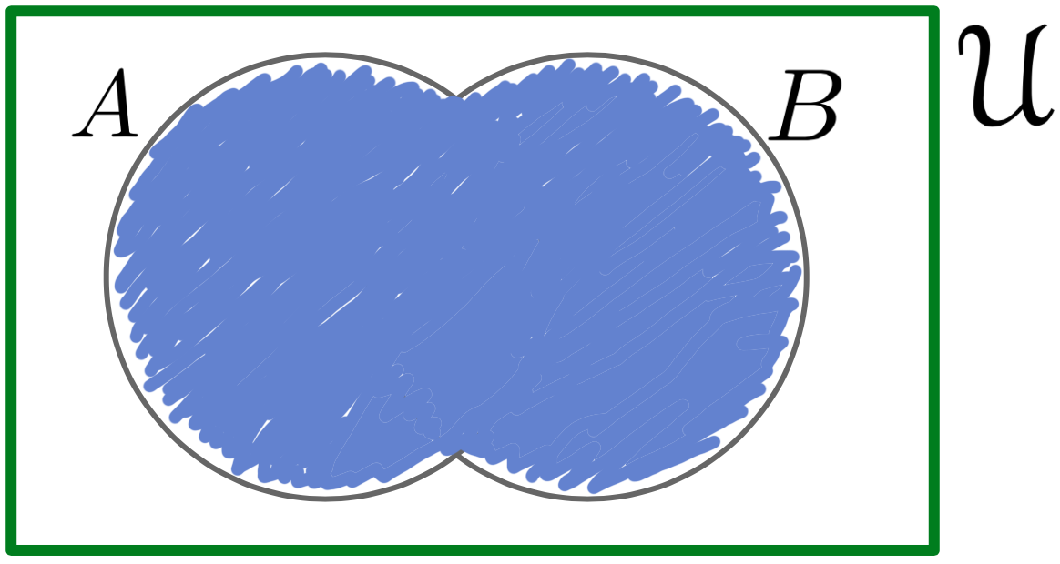
Venn Diagrams (Union)

Slide 29
Venn Diagrams (Intersection)

Slide 30
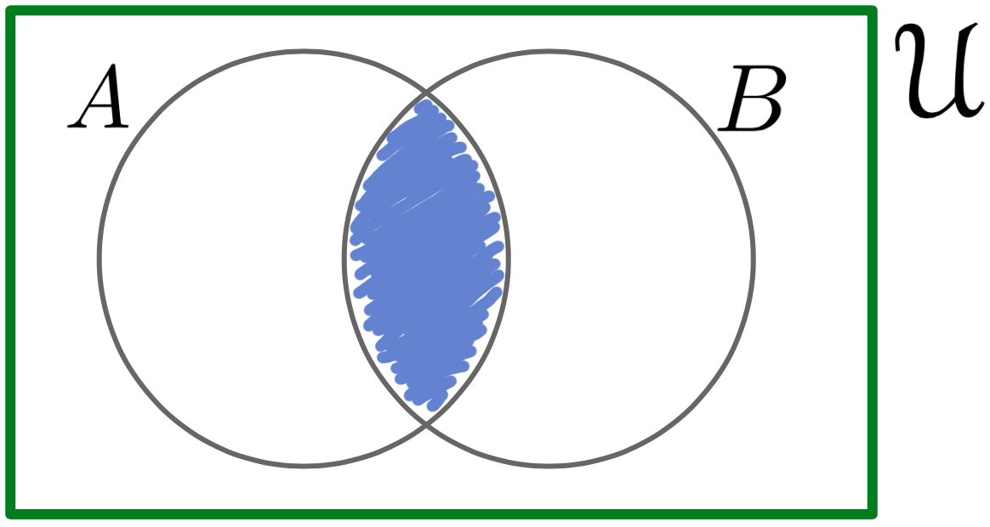
Venn Diagrams (Intersection)

Slide 31
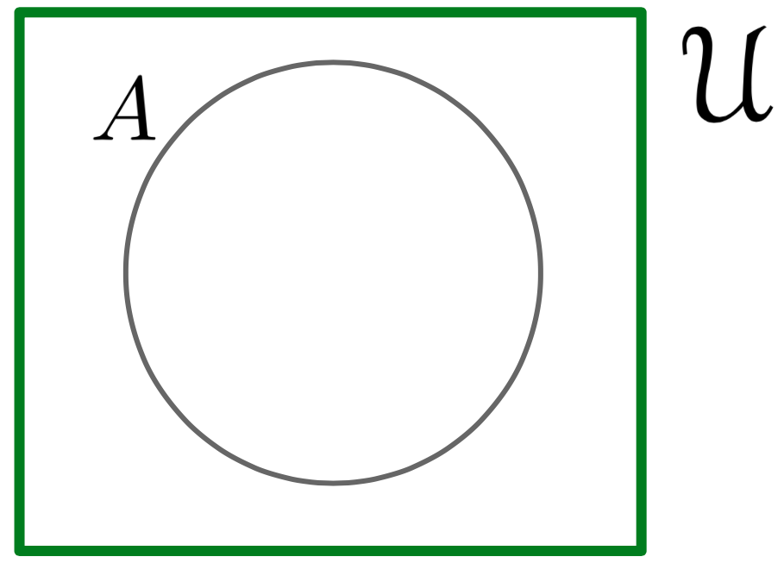
Venn Diagrams (Complement)

Slide 32
Venn Diagrams (Complement)

Slide 33
Venn Diagrams (All Together)

Slide 34
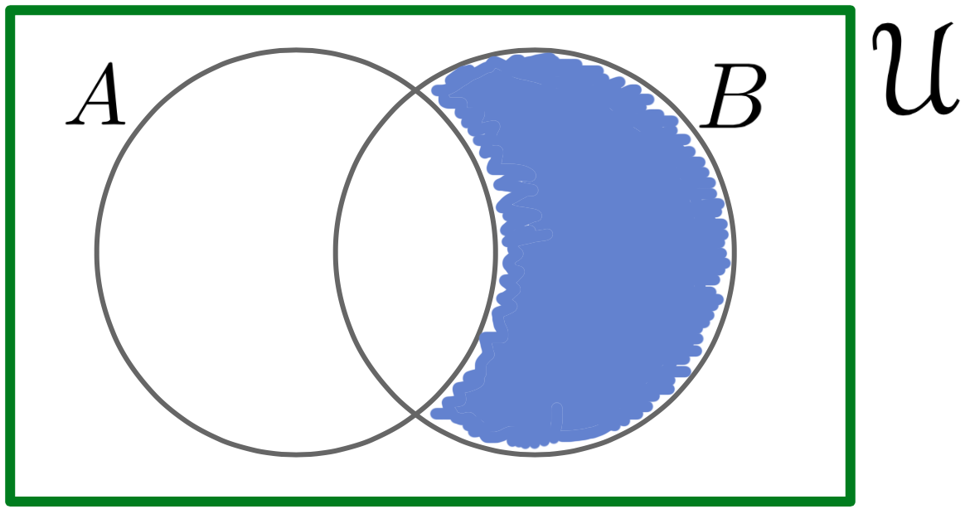
Venn Diagrams (All Together)

Slide 35
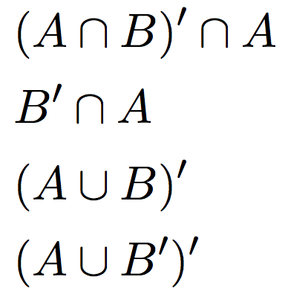
Now You Try!:
Shade in the indicated sets in a Venn Diagram for the following:

